Slide 1
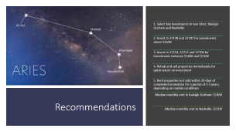

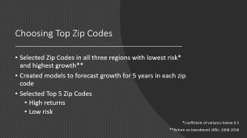


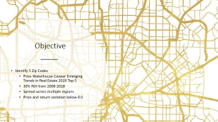


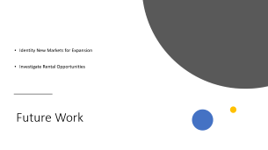
Summary

Slide 2

Aries Real Estate Investors
Finding High-Growth Investments by Zip Code

Slide 3
Agenda
Background
Objective
Areas of Exploration
Dallas-Fort Worth
Raleigh-Durham
Nashville
Choosing Profitable Zip Codes
Recommendations
Future Work

Slide 4
Background Aries Real Estate Investors
Buys and rehabilitates residential properties
Focused on high-growth urban markets
Seeking new opportunities to increase market share

Slide 5
Aries Investment Strategy
Properties purchased, Rehabbed and Sold for Profit
Properties held 30 days past renovation are rented for 3-5 years
Market conditions evaluated to determine right time to sell

Slide 6

Objective
Identify 5 Zip Codes
Price Waterhouse Cooper Emerging Trends in Real Estate 2019 Top 5
30% ROI from 2008-2018
Spread across multiple regions
Price and return variation below 0.5

Slide 7
Areas of Exploration

Slide 8
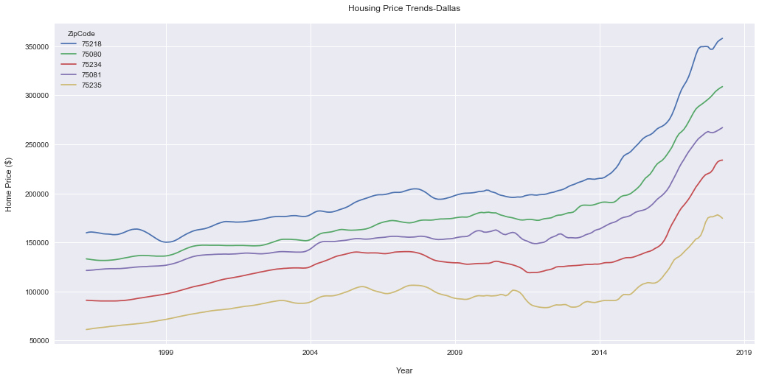
Dallas House Price Trends

Slide 9
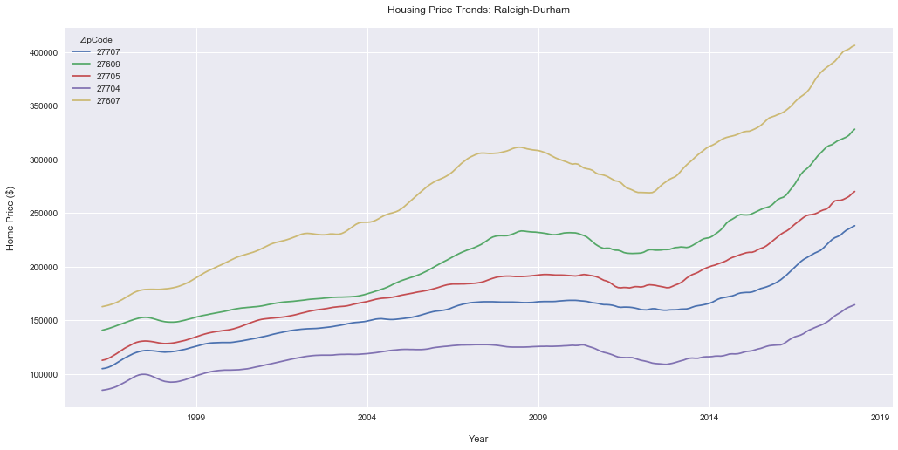
Raleigh-Durham House Price Trends

Slide 10
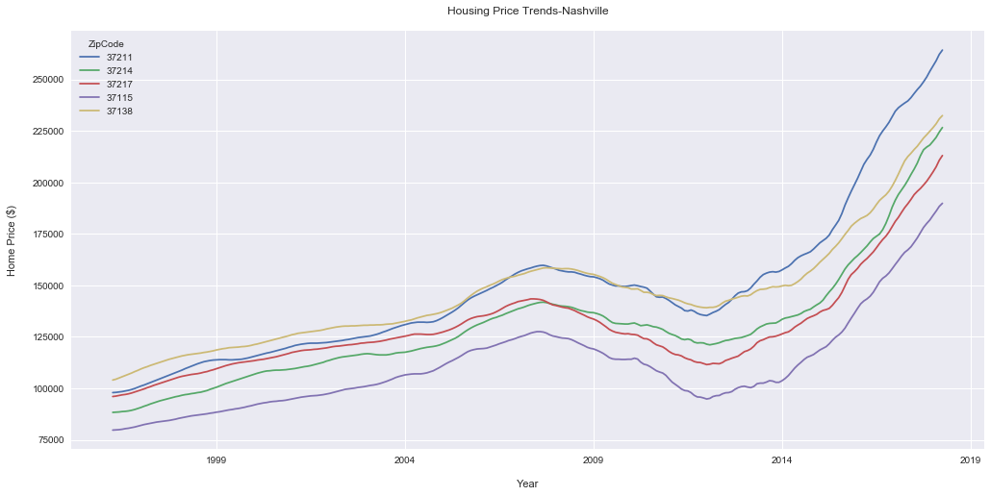
Dallas House Price Trends

Slide 11
Choosing Top Zip Codes
Selected Zip Codes in all three regions with lowest risk* and highest growth**
Created models to forecast growth for 5 years in each zip code
Selected Top 5 Zip Codes
High returns
Low risk
*Coefficient of variance below 0.5
**Return on Investment 30%+ 2008-2018

Slide 12
Recommendations
1. Select key investments in two cities: Raleigh-Durham and Nashville
2. Invest in 37138 and 27707 for investments above $150K
3. Invest in 37214, 37217 and 27704 for investments between $100K and $150K
4. Rehab and sell properties immediately for quick return on investment
5. Rent properties not sold within 30 days of completed renovation for a period of 3-5 years, depending on market conditions
Median monthly rent in Raleigh-Durham: $1400
Median monthly rent in Nashville: $1500

Slide 13
Future Work
Identity New Markets for Expansion
Investigate Rental Opportunities

Slide 15
Appendix

Slide 16
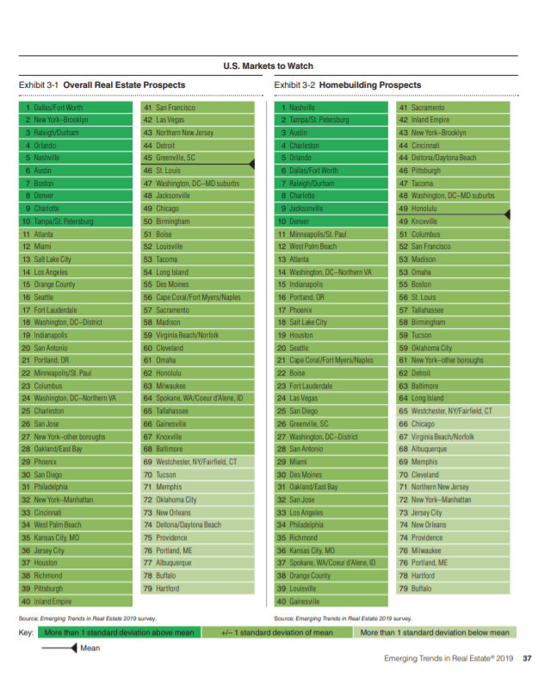
Price Waterhouse Cooper Emerging Trends in Real Estate 2019

Slide 17
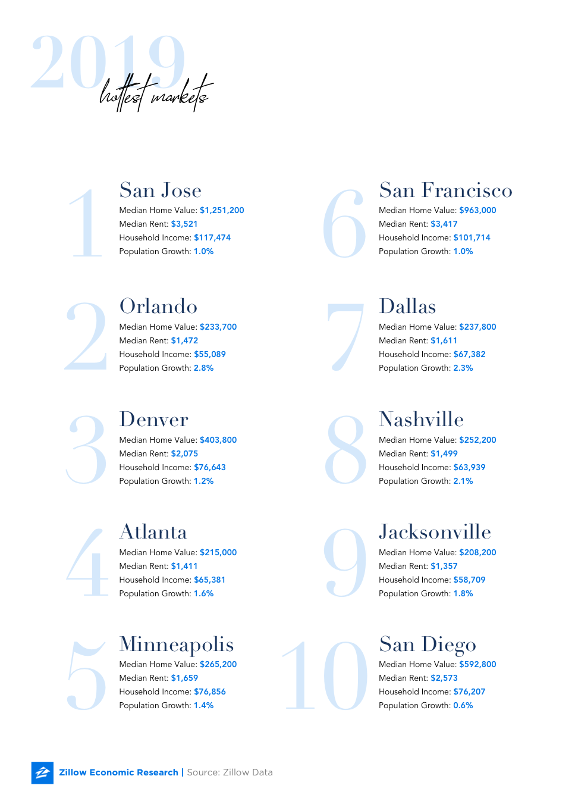
Zillow Hottest Markets 2019

